Slide 1

Console Review

Slide 2
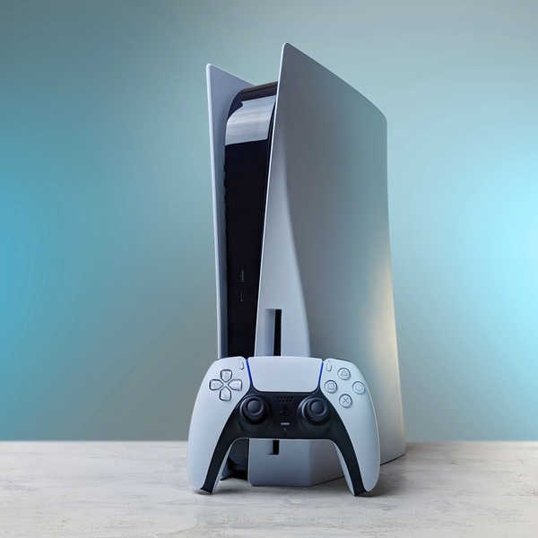
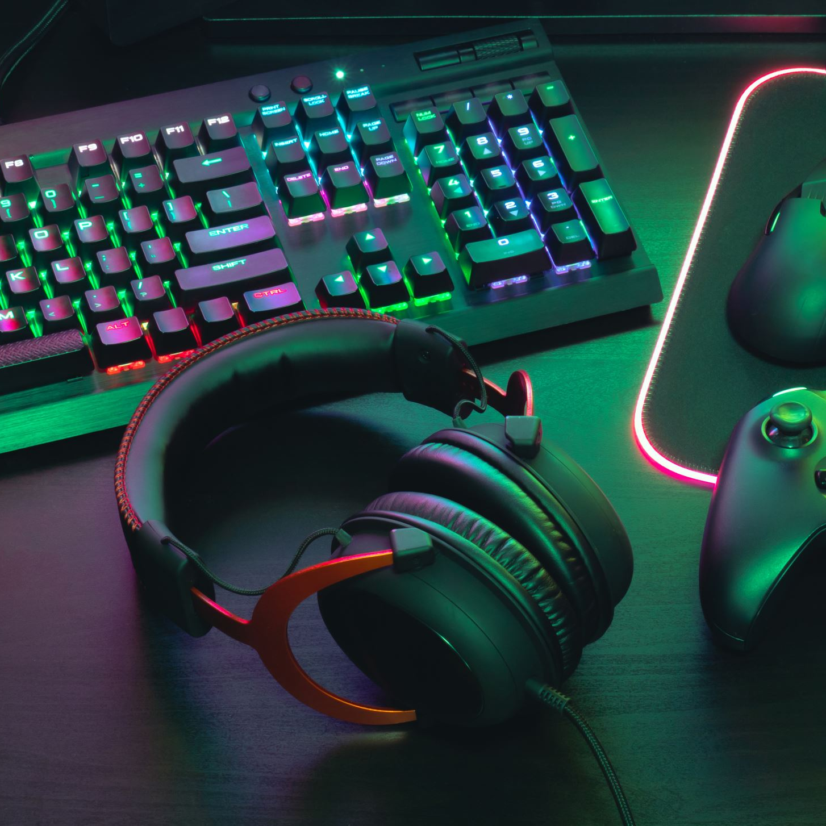
PlayStation 5.
The PS5 continues to impress with its revolutionary controller, blazing-fast load times and exclusive games

Slide 3
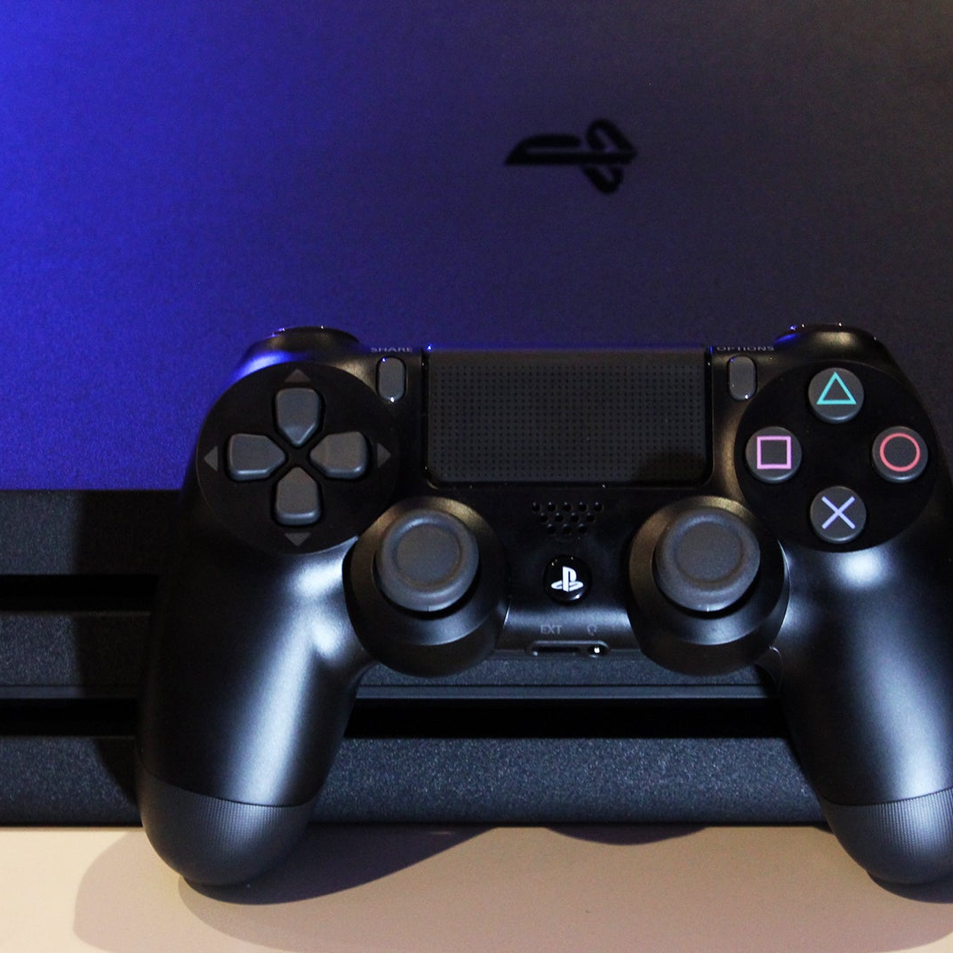
PlayStation 4 Pro
All that you need to know is that, if you have a 4K TV, then, by all means, buying a PS4 Pro is a good idea. ... The PS4 Slim can run all the games that the original PS4 and the PS4 Pro can run just fine. This includes exclusives such as Uncharted 4, Horizon Zero Dawn, Last of Us, God of War, and more.

Slide 4
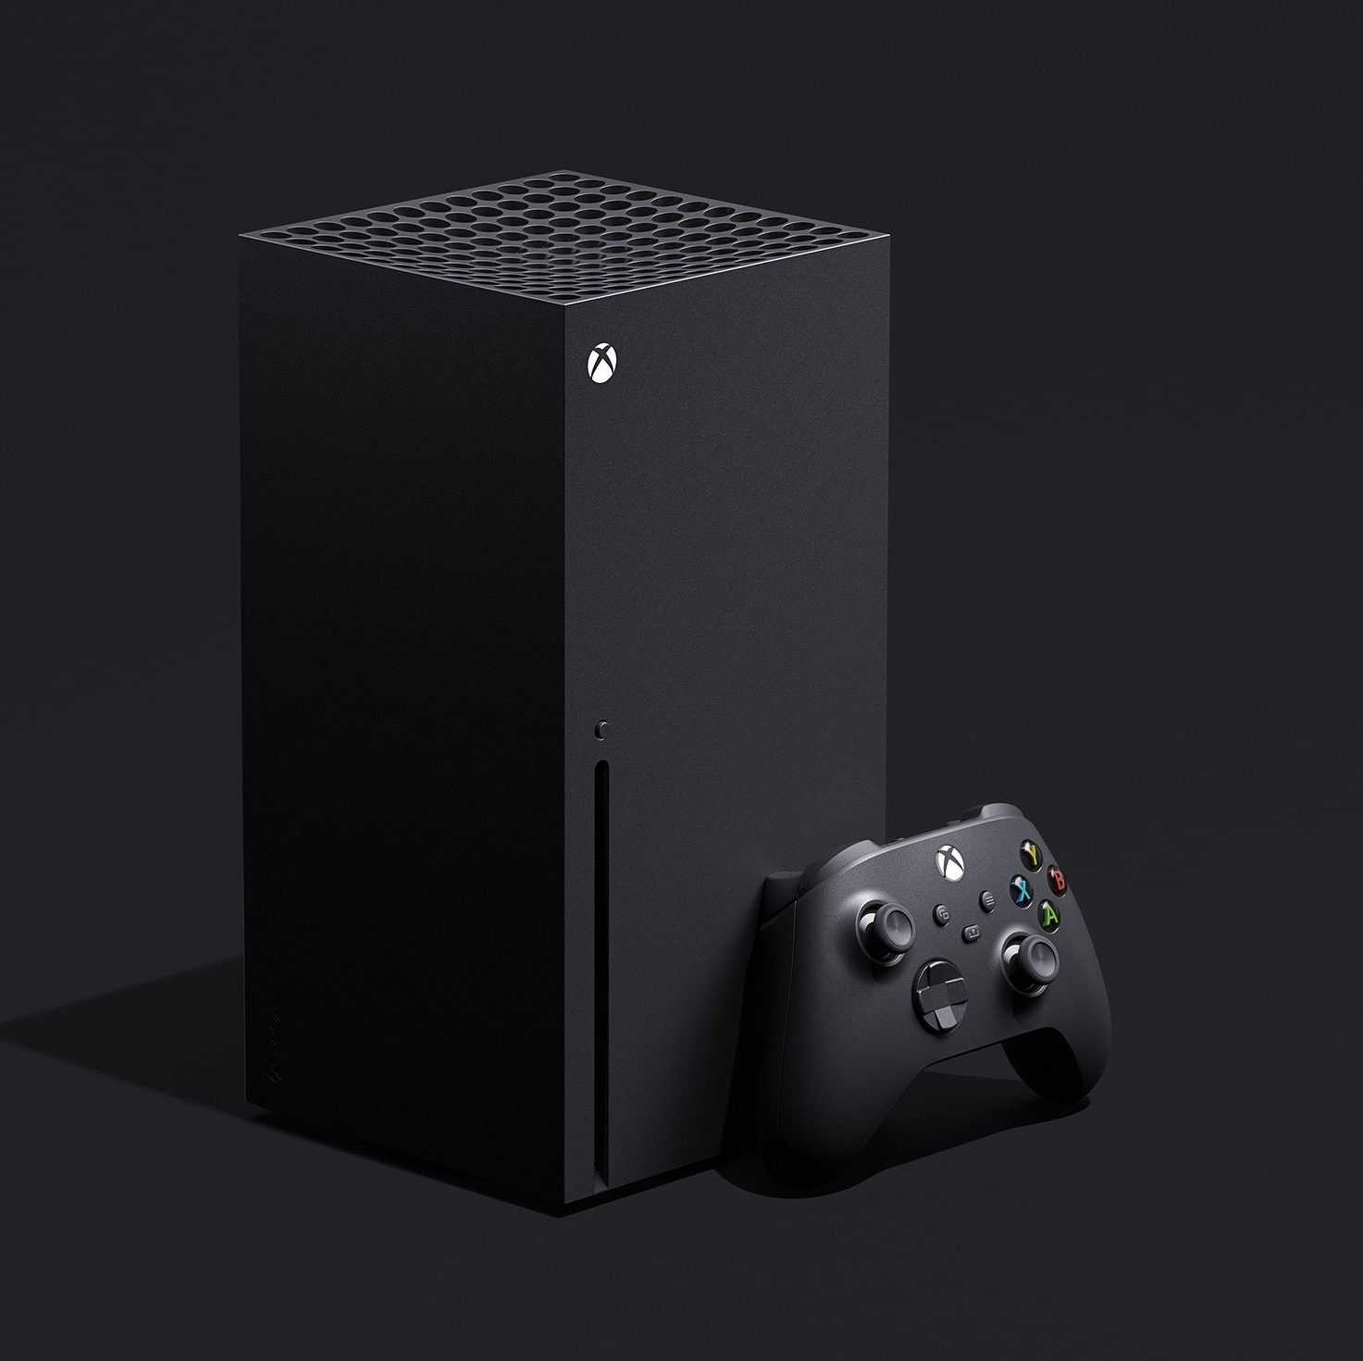
Xbox Series X
The Xbox Series X utilizes its powerful specs to significantly reduce load times and boost overall game performance and visual fidelity. But while features such as Quick Resume, Smart Delivery and backwards compatibility give it that extra edge, it’s hard to deny that it’s lacking in key areas – notably, significant UI improvements and captivating exclusive games.

Slide 5
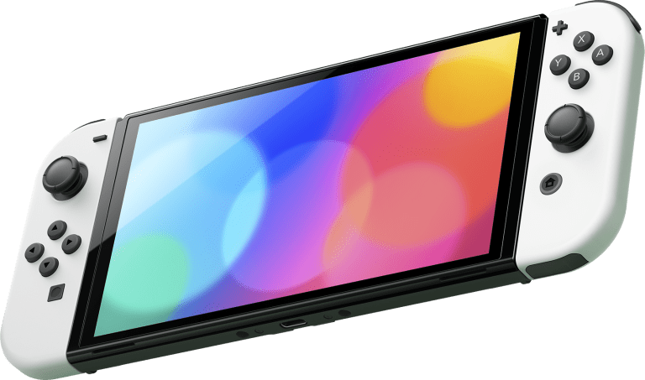
Nintendo Switch OLED.
It is still essentially the same console that plays the same games. But the OLED display is brilliant, and it makes a significant impact on the playing experience – in much the same way that the Gameboy Advance SP did almost two decades ago.

